Slide 1
Travel Planners for the Finest Bands, Choirs and Orchestras in the World
Welcome to
Your Trip

Slide 2
About Music Travel Consultants
Provider of memorable, educational performance trips since 1987
Professionally staffed by former Music Educators, Music Parents, Music Advocates and Travel Planners
Last year, over 16,000 travelers from 34 states traveled with Music Travel Consultants.

Slide 3
Pigeon Forge/Gatlinburg Itinerary
Dakota HS Choir • Dollywood Performance • Gatlinburg Variety Show
• Gatlinburg/Pigeon Forge Sightseeing Thursday - Sunday
April 28 – May 1, 2022

Slide 4
Trip Package Inclusions
Pricing is 100% Inclusive
Charter Bus, Hotel, All Meals
Entry to all activities listed in itinerary
Performance Arrangements at Dollywood
MTC Tour Director
MTC Smartphone Travel App
MTC website: Online Trip Registration / Online Trip Payments

Slide 5
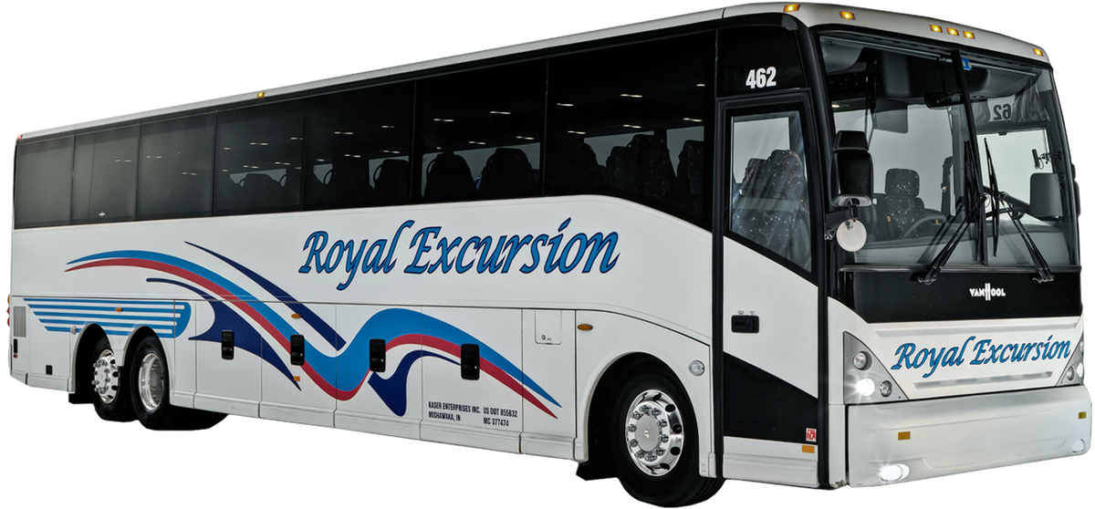
Itinerary: Thursday, April 28
6:30am Load Charter Bus (Royal Excursion)
7:00am Depart for Pigeon Forge, TN
12:00pm Lunch Enroute (meal money provided)
6:30pm Arrive Pigeon Forge
7:00pm Dinner at Mama’s Farmhouse
8:30pm Island Fountain Photo Op
9:30pm Hotel Check-in The Inn on the River, Pigeon Forge

Slide 6
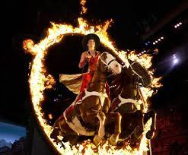
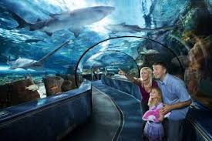
Itinerary: Friday, April 22
7:00am Breakfast at Hotel
8:00am Smoky Mountain Nat’l Park Guided Tour
12:00pm Lunch Flapjack’s Pancake Cabin / Gatlinburg
2:00pm Aquarium of the Smokies
5:00pm Return to Pigeon Forge
6:00pm Dolly’s Stampede Dinner Show
9:00pm Return to Hotel

Slide 7
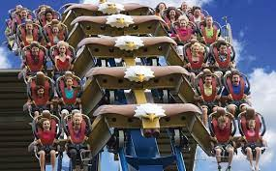
Itinerary: Saturday, April 30
7:00am Breakfast at Hotel
8:30am Depart Hotel
10:00am Dollywood Amusement Park
TBA Park Performance (pending confirmation)
12:00pm Lunch in the Park (meal vouchers provided)
TBA Dollywood Express Train
7:00pm Depart the Park
7:30pm Dinner at Hard Rock Café
9:00pm Return to Hotel

Slide 8
Itinerary: Sunday, May 1
7:00am Breakfast at Hotel
8:00am Hotel Check-out / Depart for Home
12:00pm Lunch Enroute (meal money provided)
7:00pm Arrive Dakota HS

Slide 9
Tour Conditions:
Per Person Tour Price based on Room Occupancy
Travelers 65-74 55-64 50-54 40-49
Quad $991 $1086 $883 $987
Triple $1053 $1148 $945 $1048
Twin $1177 $1272 $1069 $1172
Single $1549 $1643 $1440 $1544
The above tour prices are based on the number of paying persons traveling and may vary depending on group size when prorated costs, such as motor coach, etc., are affected. Tour prices in this proposal are based on tariffs in effect as of October 13, 2021 and are subject to change.
2 Bus
1 Bus

Slide 10
Tour Conditions: Payment Dates & Amounts
Payment Amount Due Date
Non-Refundable Deposit $75.00 November 14, 2021
Installment $185.00 December 7, 2021
Installment $185.00 January 7, 2022
Installment $185.00 February 7, 2022
Installment $185.00 March 7, 2022
Final Payment Balance Due April 7, 2022
Final payment amount will be emailed to you 30 days prior to departure. It is due upon receipt of MTC’s e-mailed invoice. Accounts not paid on or before a payment due date will be frozen.

Slide 11
Tour Conditions: Fund Raising
Music Travel Consultants encourages and welcomes the application of fund raising profits to individual or group accounts. Music Travel Consultants is unable to accept or apply any school or booster fund raising monies to accounts that are paid in full.
Last Day to apply fund raising money is: March 11, 2020

Slide 12
Last Day to Cancel with FULL Refund
(if ENTIRE TRIP is canceled)
December 29, 2021
If Trip is Canceled for Entire Group at any point 45 days or less after the initial deposit date, full refunds (including non-refundable deposits) will be given to all travelers.
The non-refundable deposit will not be refunded to individual travelers if the group still travels.

Slide 13
Last Day to Cancel with Partial Refund:
February 27, 2022
Cancellation for individuals or the entire group must be made at MTC® Online. Click on the “Cancel a Traveler” link on traveler’s/payer’s Welcome Page dashboard OR send an e-mail or written communication to MTC®.
If Cancellation is received 60 days or more prior to trip departure day, all funds except for Non-Refundable Deposits/Payments is refundable.
Cancellations received 59 days or fewer before, or on, trip departure day are non-refundable, unless a paying substitute traveler takes the place of the cancelled person.
Travelers should consider Travel and Cancellation Insurance. It may be obtained from your insurance agent or on the internet – search for Travel insurance.
.

Slide 14
Travel Insured Trip Cancellation Insurance
Available thru third-party company: Travel Insured International
Optional / Individual policy for this trip only
Provides refunds for cancellation until 48 hours prior to departure
Also includes medical coverage, reimbursement for travel delays, etc. as listed on handout
USE PRICING FROM “CFAR” COLUMN (CFAR = Cancel For Any Reason)
Policy Pricing is based on cost of trip
Trip Pricing $801-$1000 = CFAR Pricing is $45
Trip Pricing $1001-$1500 = CFAR Pricing is $61.50
Trip Pricing $1501-$2000 = CFAR Pricing is $81

Slide 15
Group Travel Protection:
Travel Insured Student Deluxe Protection Plan
Coverages may vary and not all coverage is available in all jurisdictions.
* Up to the lesser of the Trip Cost paid or the limit of Coverage for which benefits are requested and the appropriate plan cost has been paid. Maximum limit of $10,000
** For $0 Trip Cost, there is no Trip Cancellation and Trip Interruption is limited to $500 return air only
*** CFAR coverage is 75% of the nonrefundable trip cost. CFAR is optional and available for individuals or your entire group. Trip cancellation must be 48 hours or more prior to scheduled departure. CFAR must be purchased at the time of plan purchase and with or prior to your final trip payment. This benefit is not available to residents of New York State.
^{PAYMENT INFO:}
To purchase the Travel Insured Student Deluxe Protection Plan with or without Cancel for Any Reason, please see your travel leader for the group specific link.

Slide 16
Your Trip Timeline
Trip Kick-off Meeting
Pay scheduled installments due listed on Tour Conditions page.
Final Rooming List Due
(60 Days Before Departure)
Last Day to Cancel with Refund*
(60 Days Before Departure)
*Except stated non-refundable initial deposit, purchased event tickets and non-refundable transportation (bus or plane or rail or ship) costs.
Fundraising Payment Deadline
(35 Days Before Departure)
Final Invoices Sent
(30 Days Before Departure)
Final Trip Payment Due
(21 Days Before Departure)
Trip Departure Meeting
(10 Days Before Departure)
Trip Departure

Slide 17
Trip Sign-Up & Payment Program
Access your trip 24/7, anywhere you have an internet connection
View Trip Information, Invoices and Terms.
Make Secure Payments.
All accounting and billing handled by MTC.

Slide 18
Getting Started
Music Travel’s online trip registration and payment system asks for personal contact information. And, it requires payment by a major credit/debit card (below) or e-check.
Step 1: Go Online
Visit www.musictravel.com
Click “Trip Login”

Slide 19
Step 2: Click the “Register as a New User” button.

Slide 20
Step 3: Create Trip Account
Create a password, enter an email address and enter contact information.
Then click on, “Create Account”.
You will then receive the following message: “Your account has been created successfully.”
Soon, you’ll receive a confirmation e-mail.
Whenever you log in, use the email address (email address is username) and password that you just entered.

Slide 21
Step 4 (1 of 2):
Register a Traveler
Enter the Trip Number
(Given to you by your Group Leader or MTC)
Please enter the information requested, for each individual traveler, for whom you will pay. To Complete each registration, you must accept the Terms and Conditions.

Slide 22
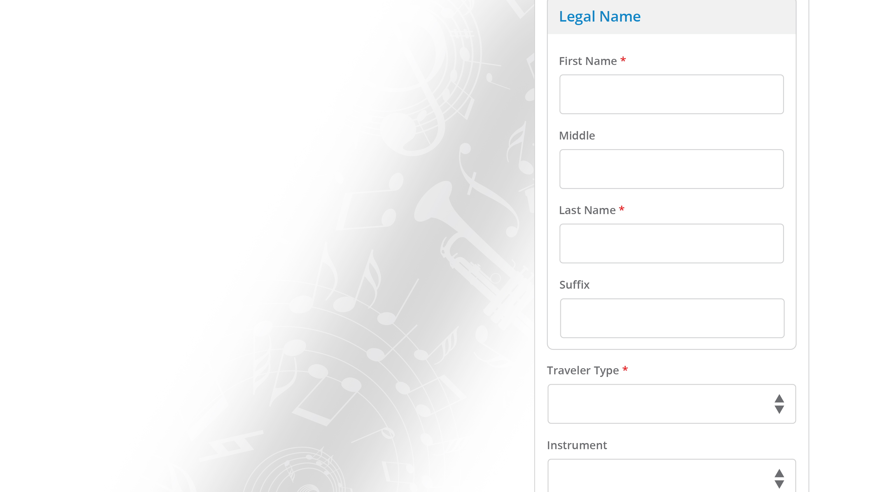
Step 4 (2 of 2): Register a Traveler
Traveler Types Explained:
Student = Member of the class or organization taking the trip.
Child = Minor sibling of a Student.
Chaperone = Adult with Chaperoning responsibility.
Adult = Adult without Chaperoning responsibility.
Fill out all required fields to complete traveler’s registration.

Slide 23
Step 5:
Your Trip Management Dashboard
When next you login, this is your starting point – your Trip Dashboard. You can:
Register a Traveler
Make a Payment
Cancel a Traveler
See Proposed Itinerary
Review Financial information

Slide 24
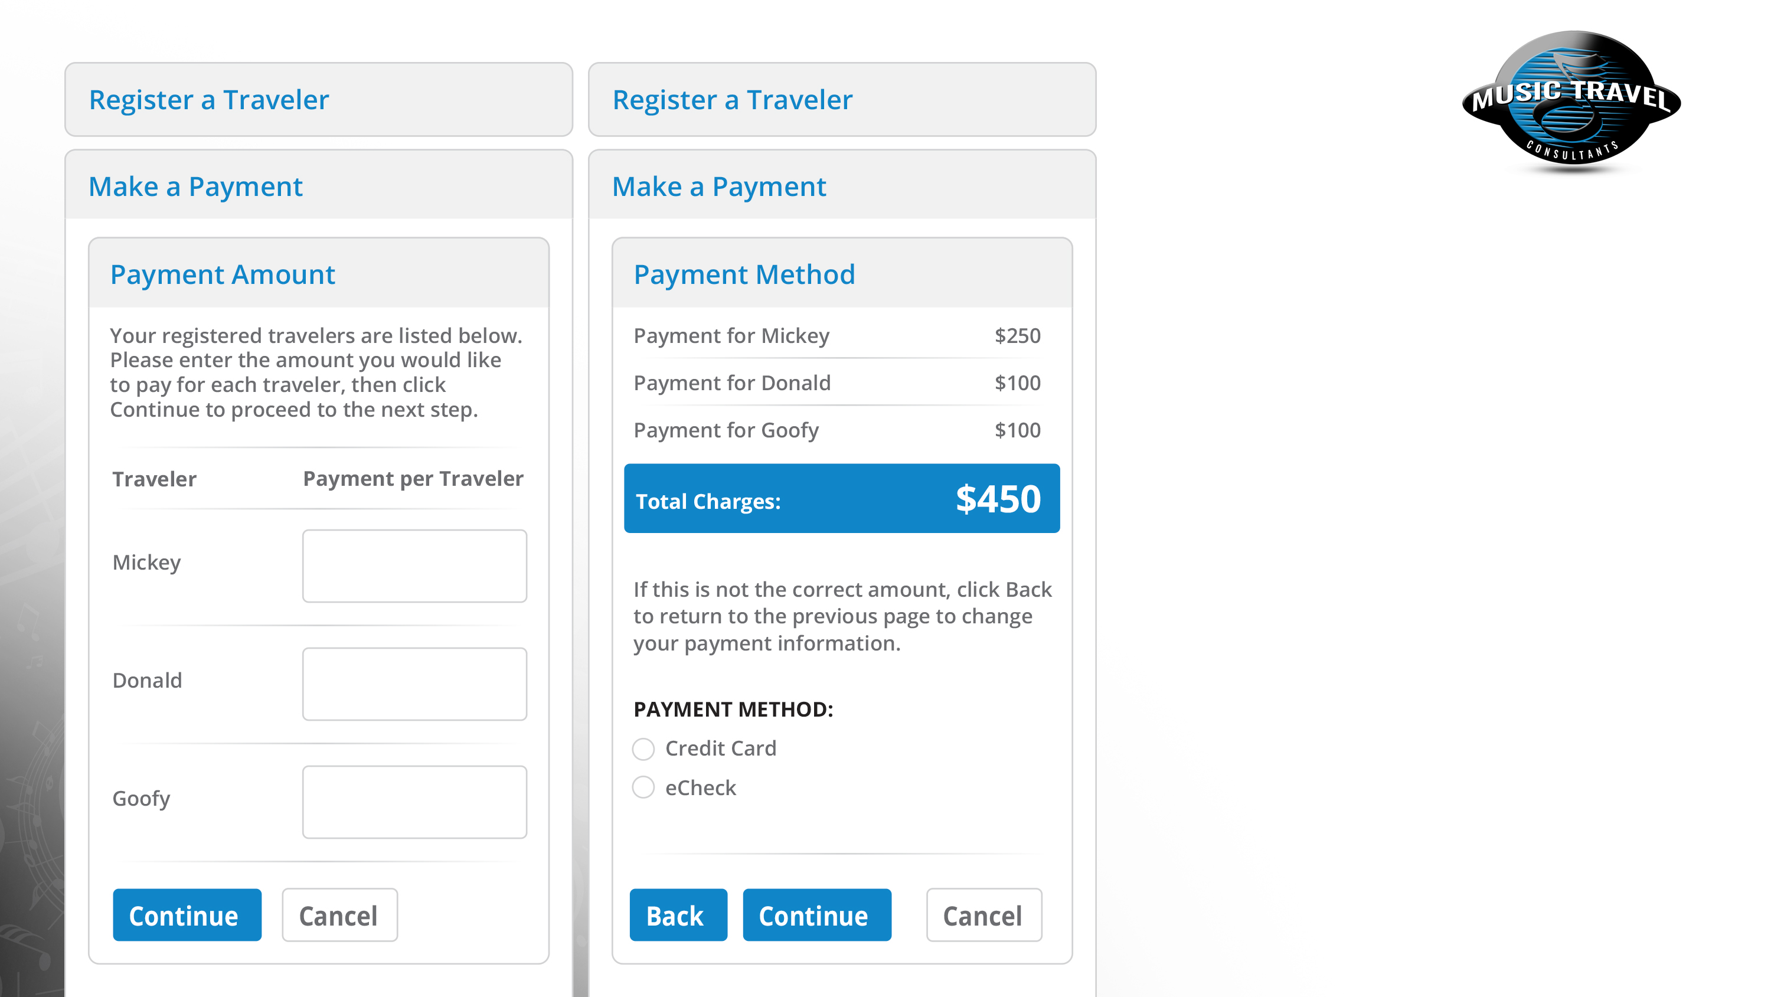
Step 6: Make a Payment (1 of 2)
Enter the payment amount for each traveler in the box next to the Traveler’s name. Dollars and cents only – no Dollar signs. Click, Continue. (if paying nothing, enter “0.00”). The second screen gives the total.
Enter payment method, click ‘Continue’.
If wrong, click ‘Back’.

Slide 25
Step 6: Make a Payment (2 of 2)
Enter Credit Card or eCheck information, including card/account number, security code and name as it appears on the card/eCheck, plus card billing address and Email Receipt address.

Slide 26
Music Travel Consultants: Contact Information
Tour Questions: Jeff Buchanan 419.419.2664
Email Address: jeff.buchanan@musictravel.com
Email Financial Questions to: Barbara Sherwood
Accounting Email Address: Barbara.sherwood@musictravel.com
General Information:
Website: www.musictravel.com
Address: 5348 W. Vermont Street, Suite 200 Indianapolis, IN 46224
Phone: 800.616.1112
Office Hours: Monday - Friday 8:00am - 4:30pm Eastern Time Office Hours:

